Slide 1



EMOPERS
Emotion intervention through Audio/Video
By Stuti Gupta, Akshayaasri Sridharan , Patrick Walker, Nivetha Anandakrishnan, Rinku Kaneria

Slide 2
INTRODUCTION
Our team has developed a single-page Python application which performs emotional intervention.
Our application runs EmoPy checking for the emotions Anger and Happiness.
We attempt to get the user’s mood to change from Anger to Happiness, after viewing a short (under 5 minutes ) video.
After the video is finished we run a follow up EmoPy evaluation to see if the intervention was successful (Anger Happiness).
Notes:
We originally weren’t sure what to do with users who are already happy. One option was to simply not do anything (close app if initially detected happy). In the end we decided that we might want to take the opportunity to still intervene but instead of trying to make their mood improve, we could focus on motivating them. This ties in with one of the motivations for this application being improving the mood of students or workers to get a better performance out of them (be it a quiz, test, task, or project). People who are happy and not angry tend to be less stressed and perform better.

Slide 3
Technology Used
Our application runs EmoPy’s fermodel_example_webcam.py on the back-end, to detect the user’s emotion through an image captured from their webcam.
It uses a Python Framework called Flask, and displays a locally stored HTML file on the front-end.
Flask is a web application framework written in Python.
Flask is based on the Werkzeug WSGI (Web Server Gateway Interface) toolkit and the Jinja2 Template Engine.
Flask does app routing, allowing us to run various sections of our Python code based on the current url path.
These paths are set within the JavaScript script and are based on where the user currently is, in the execution states of our program (follow-up/validation run, or shutdown.) .
We pass values from our JavaScript code to our Python code using ajax POST calls. With Flask we can easily retrieve these posted values from within the Python script, allowing us to communicate between the Python file and JavaScipt script.
Notes:
This slide covers all the technologies used in our application.
The reason we use JS is to give a better user interface, and allow for dynamic HTML. Future enhancements could incorporate user IO to get feedback from user (regarding what type of intervention they would prefer...music/funny video/sports video, or if they choose music ask what genre of music they prefer) then use that feedback to decide on how to intervene (what data to use).This is a single-page application: only includes one HTML file that is dynamically updated based on the results of EmoPy evaluation, and what state the user is at, in the running of the application.

Slide 4
APPLICATION PROCESS
Match with DataSet
Capture Image
Predict Emotion
Show Video
Happy
Quit Application
Run EmoPy
In Background
Start Application
Show Video
Anger
YES
Validation Run
Continue Watching Video
NO

Slide 5
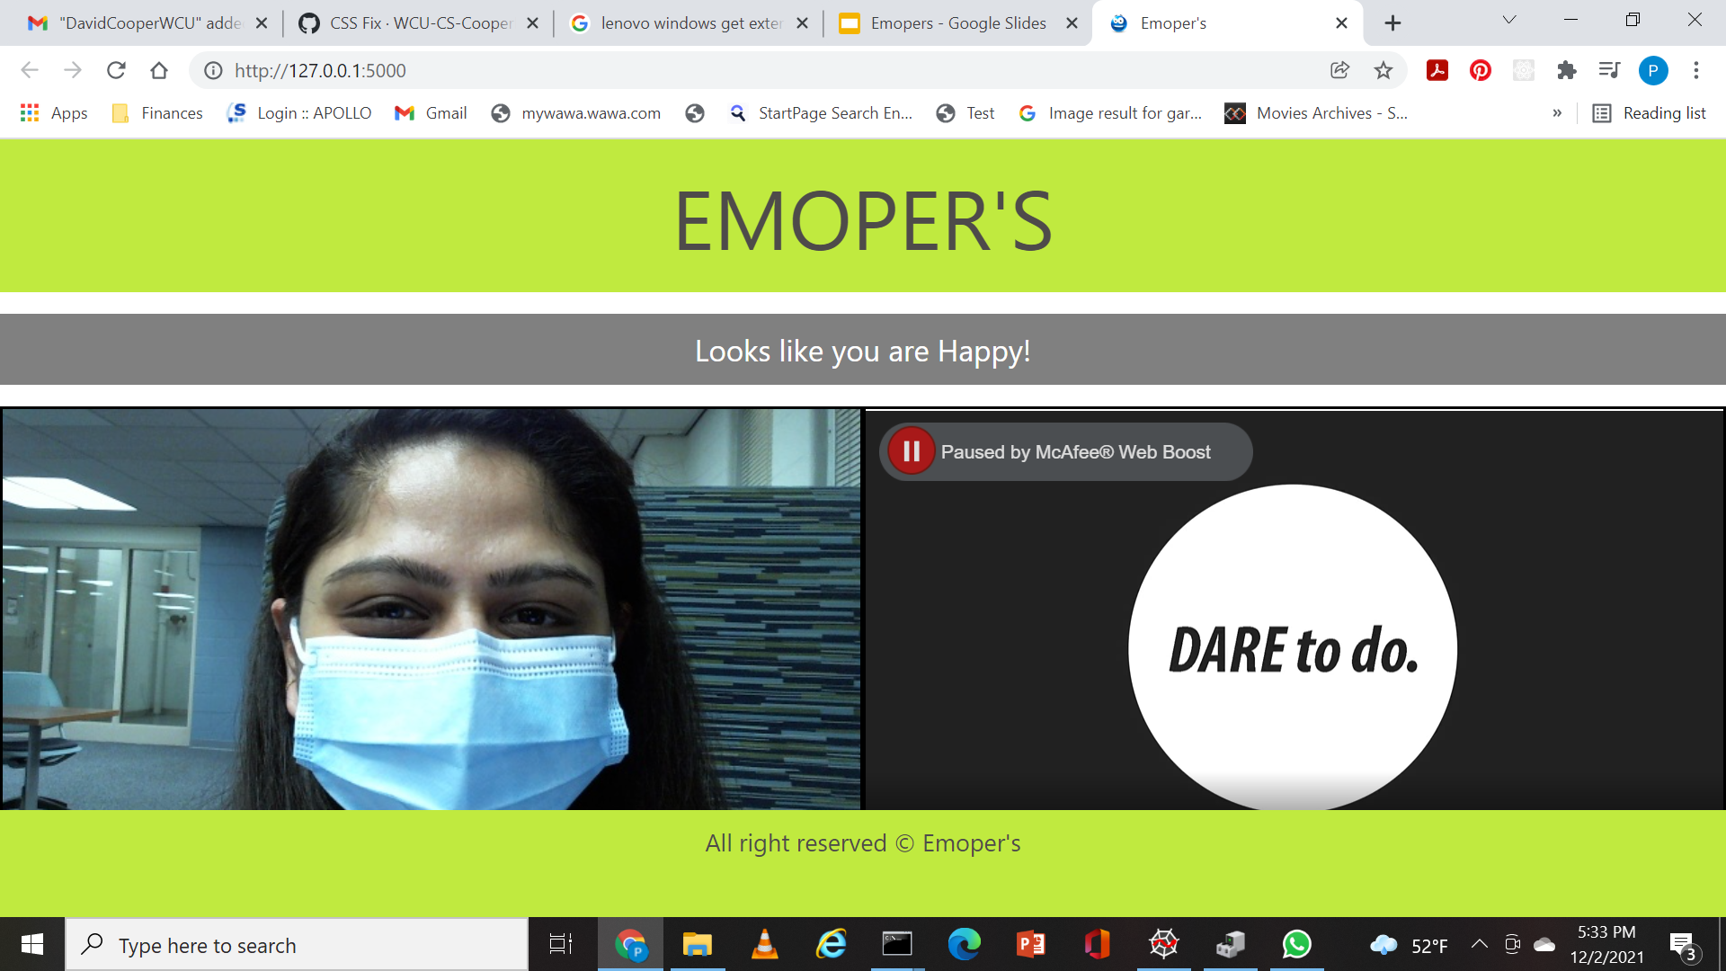
USE CASE 1
If user is detected Happy in initial evaluation, we will display a video with a motivational message, and then exit.
Notes:
Here since we aren’t interested in changing their affect, we instead focus on motivating them. We originally didn’t know what we wanted to do in this case, since the user is already in a good mood. Rather than not doing anything we choose to try to motivate them to see if this could help improve their performance in a subsequent task. The motivation is just general motivation to get the user to try their best, set high goals, and never give up. We are trying to get the users to live up to their full potential.

Slide 6
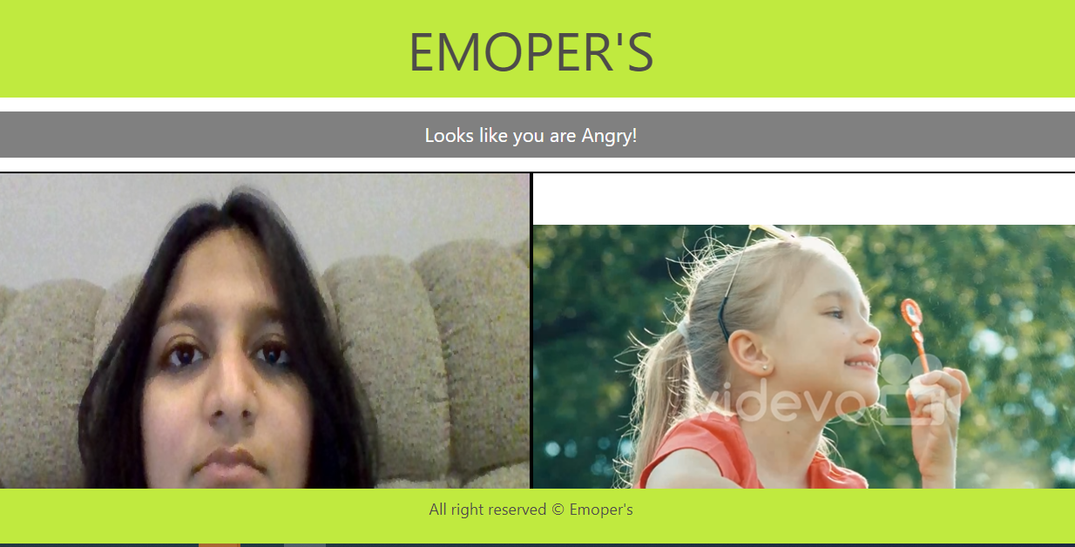
USE CASE 2
If the user is detected as Angry, we intervene by playing a video (either funny videos, controlled breathing exercise or calming music) to see if we can induce positive change in the person’s affect.

Slide 7
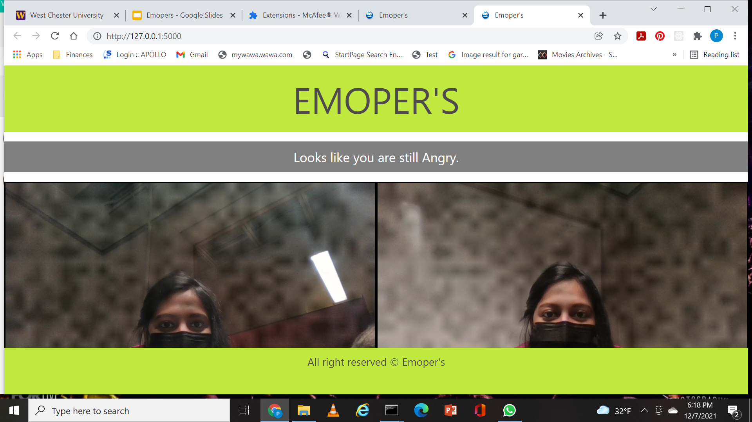
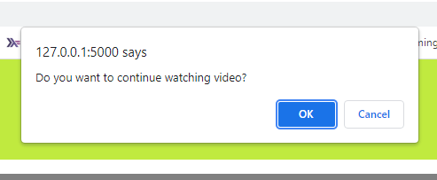
USE CASE 3
After the first intervention, we run the evaluation again to see if their emotion changed. If they are still angry then we ask user whether they want to continue watching video. If replied YES. We repeat the whole process until user quit or their emotion changed to Happy.

Slide 8
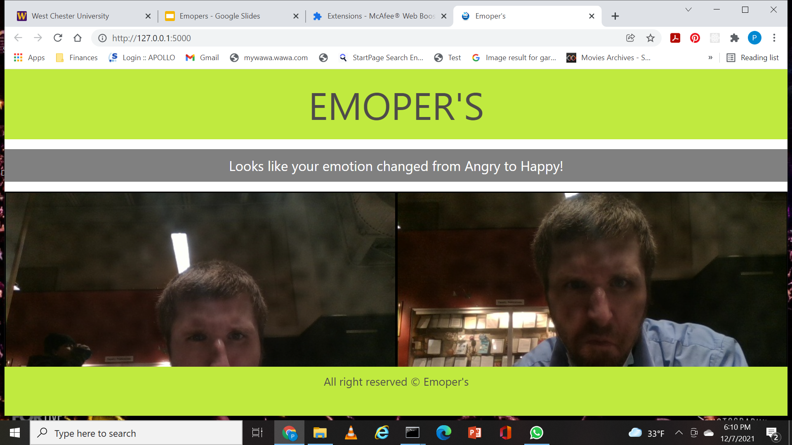
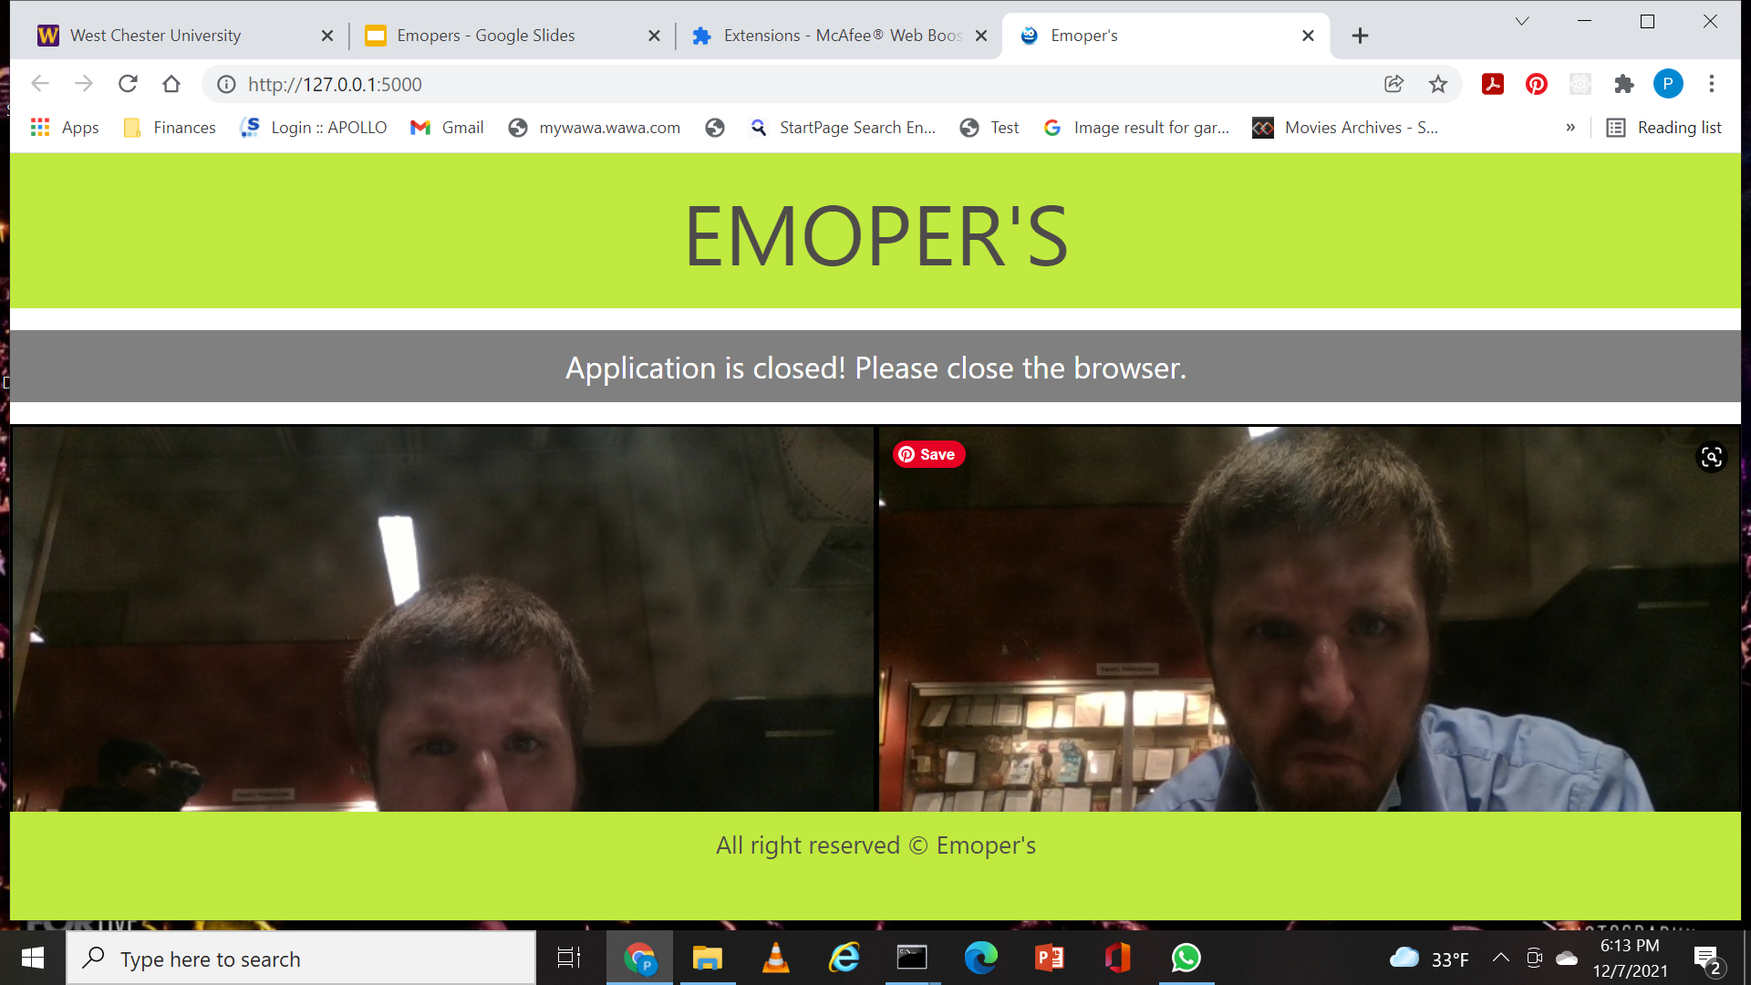
USE CASE 4
After the first intervention, we run the evaluation again to see if their emotion changed. If they are still angry then we ask user whether they want to continue watching video. If replied NO. We quit application.

Slide 9
PURPOSE
Emotional intervention tool focusing on transforming emotional status anger to calm/happy.
In a real world scenario this tool can be used in schools , work-place , etc.
Research shows that explicit SEL interventions are effective in helping students develop social-emotional competencies and even boost academic achievement.
Employees are 13% more productive when they are in a happy mood.
Existing mood detection apps can use this model to help change the mood rather than just detecting a person's mood.
Notes:
The main purpose of this project is when we thought it would be a good idea to utilise the emopy application to act as an intervention tool. This intervention is mainly for the emotion “Anger”. We are focusing on anger since its one emotion that can be changed with help of an intervention.
Real world scenarios: In school this tool can be used to determine the emotional status of a student before taking up an exam to calm their mood, Why this might be helpful for students especially is that when children are really young to determine their emotional status this tool might be a guide to intervene the emotion. Social Emotional Learning intervention. In workplace Happiness is the key if you are angry it's really tough to work productively. There is a research that says employees are 13% more productive when they are happy. This kind of intervention tool can be useful to keep themself calm.
A study at a British telecommunications firm run by Oxford University's Saïd Business School found that happy workers were 13% more productive. That research tracked 1,800 workers and their personal feelings of happiness over a series of weeks. found here
https://www.forbes.com/sites/forbesagencycouncil/2021/04/16/if-you-want-to-be-more-productive-at-work-get-happy/?sh=4cf828307be2

Slide 10
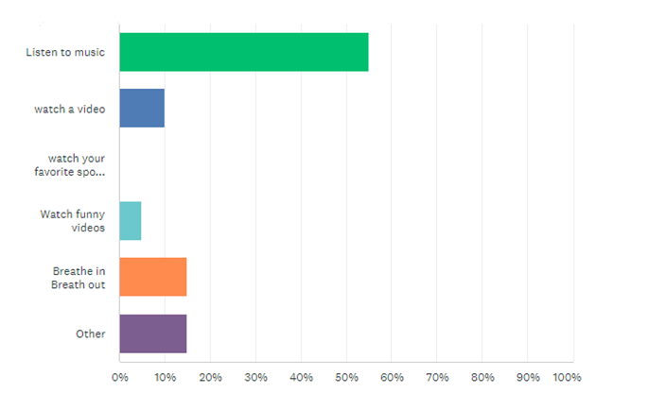
Survey
Notes:
A survey was conducted among students and friends to determine the best intervention videos to use in our dataset.
The survey showed a large number of people responded to anger by watching a funny video, listening to music, doing breathing exercise.
We implemented playing videos in our web app, to intervene with an Angry user.
There are also a significant # of people who responded with “other”. It would be nice if we could have included a spot for them to include what this other intervention would be, but this was a limitation of the survey. (Is this correct? If not might not want to mention.)

Slide 11
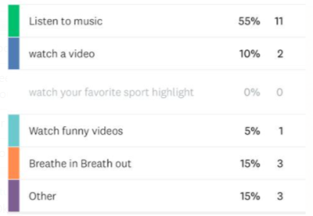
What would you do to change your mood from anger to calm ?

Slide 12



DATASET
DATASET consist of short videos with calming music, breathing exercises and funny videos to play after the intervention detects that they are Angry.
If they are detected as Happy the dataset also contains short videos with motivating messages that will be played.
Notes:
Make sure to mention that the videos of the dataset match the % of intervention types prefered in the survey, and that they were ripped from youtube using youtubedl.py an open source program run at the command line that manages downloads from youtube and various other sites. Also should probably mention that we originally weren’t sure what to do for happy users since we don’t want to change their emotion. We decided on simply displaying videos containing motivating messages in hopes that if the users are in a good mood then these messages might be more likely to get through to them/have an effect on them. This ties into one of the motivations for the app (or situations it could be used in) being to help students or workers achieve better scores/results on tests/evaluations/projects.

Slide 13
DataSet
Type of Dataset - mp4 , Excel with links to videos (Future)
Total Number of Video - 11 for Angry users and 4 for Happy users
Video include :
Funny/cute animal Video
Breathing Exercise
Calming Music
Motivating messages (for users who are already Happy)
Notes:
They include funny/cute animal videos, breathing exercises, and calming music with peaceful imagery.
Most were ripped from youtube using youtubedl.py, and converted if necessary using free converter at https://www.freeconvert.com/mp4-converter

Slide 14
EVALUATION
We were able to change user’s emotion from anger to happiness.
Out of 20 we were able to change 8 of angry user to happy
Notes:
Here is where we can add all the images we collected and the results (if we tried to look angry did it think we were angry? ).
If a follow-up task is involved how did they do (compared to those who didn’t receive the intervention)?
Research could be conducted where a control group is not given this intervention and a test group is, and they all complete th e same follow up task or examination. We could compare how the test group did overall compared to the control group, to evaluate how successful this intervention was in not only improving their mood (according to emopy), but also in the subsequent task at hand.

Slide 15





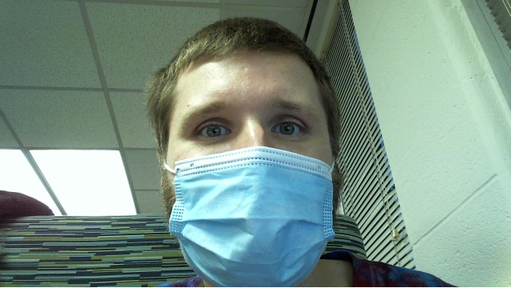

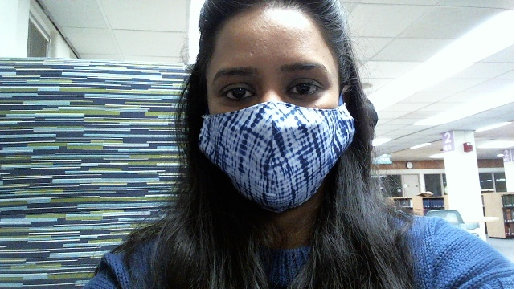
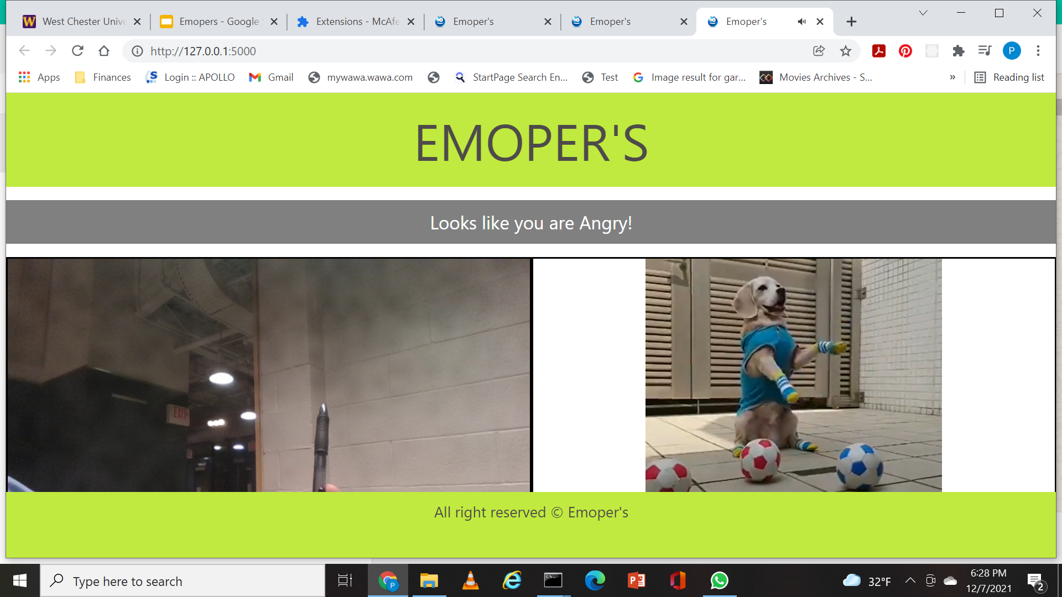
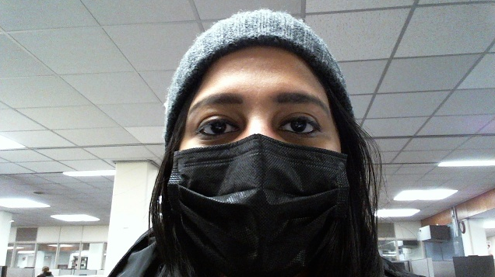
EVALUATION
100 % Angry
100 % Angry
77% Angry
100 % Happy
50 % Happy
81.8% Anger
66 % Anger

Slide 16
CHALLENGES FACED IN DEVELOPMENT PROCESS
Running videos on autoplay without being muted.
Getting values passed from Javascript to Python.
Getting browser tab to close after intervention finished.
Setting final instructions for setup application that works for Mac OS and Windows OS.
Collecting videos based on different situation (for this we used youtubedl.py application).
Notes:
– we have face some situations like
Since most users have Chrome as a browser, we ran into the issue of, starting videos with autoplay un-muted.
In google chrome this isn’t allowed (will only let you autoplay muted videos or play unmuted with controls/not autoplay). We needed to update chrome settings to get video to run autoplay and un-muted. Otherwise it appears with controls and the user needs to press play button to start it with audio.
Getting the active browser tab to close after intervention:
Since, we open the browser with flask not JavaScript we couldn’t find a way to close the current browser tab. We did find a way to close the browser using python, but it would close whole browser, not just active tab.
So, if a user had other tabs in opened in their browser, then they would all be closed and the user would become Angry again!!.
Through research, we found a potential solution called selenium that could be helpful for this problem, but given the time constraints we weren’t able to implement.
Setting final instructions for set up the application that works for Mac and Windows.
We faced couple hard situations where we have change setting instructions many times.
Collecting videos based on different Situation.
Intervention data like videos, music based on situations like students before exam, people at work.

Slide 17
FUTURE ENHANCEMENT
In future work we can adjust the code to detect other emotions limited to the subsets of emotions provided by EMOPY.
Change the intervention methods to include adding
Intervention by Self talk
Intervention by playing an online game.
Intervention by listening a self playlist.
Intervention by creating a conversation.
Notes:
Other emotions like fear, disgust, sadness can be used in future work. In this current intervention project we are only determining an individual's emotion and playing a video/motivational quotes. However the overall intention is to create many different types of intervention based on individual interests. There are other types of interventions like self talk where you the intervention can turn on a recorder that acts a self talk listener where you can express your anger in words to make your mood better. Intervention by asking the individual to tell his/her preference or creating a conversation on
How are they feeling today ?
Is there a way we can make their mood better?
Are they interested in talking to us about what's bothering them to be in this negative mood.
how they want this intervention to be. The more data we collect the better interventions can be created based on individual inputs. IT can be more of an interactive tool that acts as an intervention.

Slide 18
Conclusion
In conclusion we feel like there is a lot more we could have done with this application, had we been given more development time.
We ran into several hurdles along the way, but in the end came out with a working prototype that we are proud of.
Would any of you be interested in having an application like this to use in your personal life or at work?
Our code is available online at https://github.com/WCU-CS-CooperLab/emopers.git if anyone would like to look at it or try cloning and running the application.
Notes:
Maybe mention here we would have considered checking for sadness but there was no {sadness,happiness} or {sadness, ager, happiness} sets. If would have been interesting to be able to attempt intervention for sadness and anger in different ways to see if one approach works best for each specific emotion. This was one of the limitations (limit within emopy itself).

